Slide 1
Third presentation

Slide 2
Agenda
How the comunication between laptop and robot works
Path planning resources
Where to begin?

Slide 3
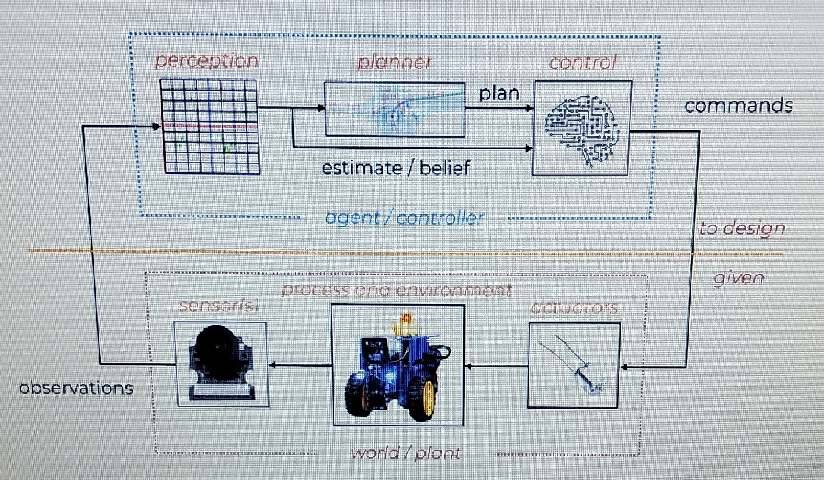
How the communication works

Slide 4
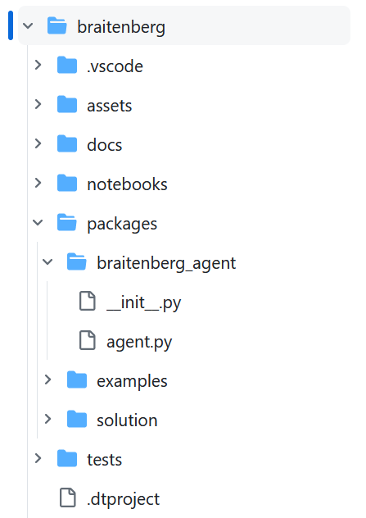
dts code workbench --duckiebot YOUR_DUCKIEBOT
agent.py performs the corresponding computations given the observations of the robot and gets the commands (move motors, turn on leds).

Slide 5
Path planning
Environmental Modelling
Traditional environmental modeling methods
Model-based approach.
Based on stereo vision method.
Based on raster map method.
Based on sensor fusion method.
Based on deep learning.
V2X-based environment modeling method.

Slide 6
Global path planning algorithm
Traditional algorithm of map-based path planning
Dijkstra algorithm
A * algorithm
D * algorithm
LPA * algorithm
D * Lite algorithm
Comparison of traditional algorithms based on maps
Path planning algorithm based on bionics
Genetic algorithm
Neural network algorithm
Ant Colony Algorithm
Sampling-Based Path Planning Algorithm
PRM algorithm
RRT algorithm

Slide 7
Path planning
Environmental Modelling
Traditional environmental modeling methods
Model-based approach.
Based on stereo vision method.
Based on raster map method.
Based on sensor fusion method.
Based on deep learning.
V2X-based environment modeling method.

Slide 8
Some python path planning algorithms:
https://www.awerobotics.com/implementing-path-planning-algorithms-for-robots-using-python/

Slide 9
Vielen Dank
Brita Tamm
502-555-0152
brita@firstupconsultants.com
www.firstupconsultants.com

